Slide 1
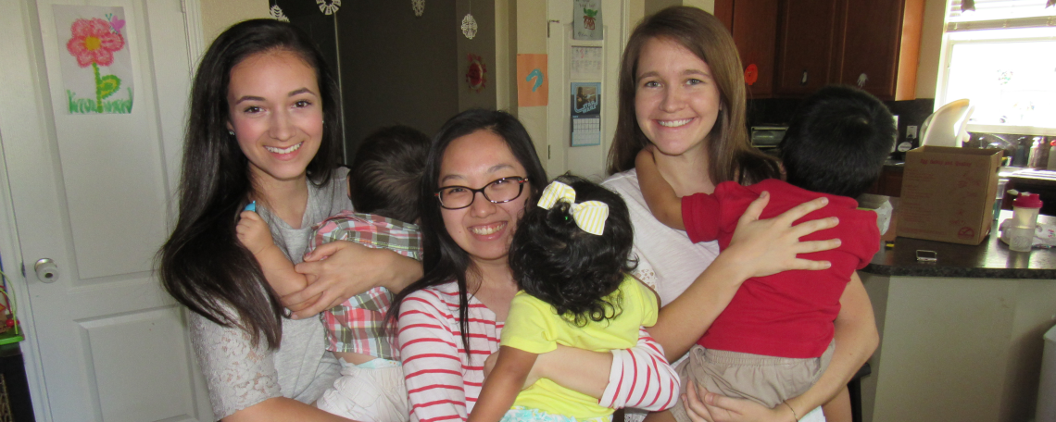
Have you ever wanted to do a Half Marathon or a 5K or 10K?
Now's your chance! Join Team Casa de Esperanza on
September 24, 2016
Join our team today!
Step 1: Register for your event at http://runuofh.com
Step 2: Join our team at http://goo.gl/Wr439p
Step 3: Share your donation page with friends and family
For questions about joining our team, please contact kgriffin@casahope.com

Slide 2
Instructions
Replace top logo with your nonprofit logo
Change border and text colors as desired
To create a short STEP 2 URL, go to https://goo.gl/
Change image/picture and contact information
Call 713-322-7150 or email support@reason2race.com with questions

